Slide 1



PRODATHON 2K23
Quiztopia – An Online Quizzing Platform
PRESENTED BY BATMAN’S UNITED
BHUVAN [EEE]
ABHISHEK [EEE]
MANOJ [EEE]
SKANDA [AIML]
SNEHA [AIML]

Slide 2



QUIZTOPIA Building an engaging platform for online learning
PS7. In the age of digital education and online learning, there is a growing demand for engaging and informative quiz websites. Create a platform to host quizzes
In the age of online degrees and classes, every student is easily distracted by electronic gadgets. Hence there is a large need to engage everyone on electronic gadgets for a good purpose. Hence our team decided to choose PS7 as problem statement to keep this generation motivated and attain more knowledge.

Slide 3

Purpose: This web application provides facility to Play online quiz and practice Grammar, Aptitude, and G.K. It provides a good platform, where a student not only judges there knowledge/skill but also they can improve knowledge/skill at the same time.
Scope: The Scope of this project is very broad in terms of gaining knowledge and sharing knowledge among world. Few points are:-
Can be used anywhere any time as it is a web based application.
This application will be used in educational institutions as well as in corporate world.
Applicability: Anyone, whether a newcomer or professional, willing to learn they can choose it . All users will have access to all subject containing sub topics Users will receive best experience without any interruptions.

Slide 4
Description :
Firstly, we have to make interfaces for Home Page, Login Page, Questions Attempting forum , Score Card.
Methodology: The programming language used for the development of the project is JAVASCRIPT,CSS AND HTML.
Improvement:
These all pages can be connected with the server and database.
Currently, there are websites which only provide limited number of quizzes related to different domain.
Many websites do not have a single platform for quizzes related to technical, G.K, Aptitude, Games, etc. And there is not a website where the users can upload his/her questions and answers for the others.
We have to develop an application which can resolve all of the above problems. By this user can gain knowledge, can solve his/her query, and spread his/her knowledge among the world.

Slide 5

Introduction
Welcome to this exciting presentation about the future of digital education and online learning! As technology continues to advance, so does the demand for innovative and engaging ways to learn online. One of the most effective methods for retaining information and keeping learners engaged is through quizzes. That's why today, we're going to explore the benefits of quizzes and how you can create your own quiz platform to meet the growing demand.
In the age of online degrees and classes, every student is easily distracted by electronic gadgets. Hence there is a large need to engage everyone on electronic gadgets for a good purpose. Hence our team decided to choose PS7 as problem statement to keep this generation motivated and attain more knowledge.
In this presentation, we'll discuss the importance of quizzes in the context of digital education and online learning. We'll also delve into the process of creating a quiz platform and provide practical insights on how to create engaging quiz content. Finally, we'll touch on the importance of marketing your quiz platform to reach your target audience. So sit back, relax, and get ready to learn about the exciting world of quizzes in digital education!

Slide 6

The Benefits of Quizzes
Quizzes are an essential tool for digital education and online learning. They provide learners with a fun and interactive way to engage with course material, while also testing their knowledge and understanding.
Students normally lack knowledge in many fields and don't have much exposure in it. Many questions in their minds go unanswered. These quiz websites helps them to gain more knowledge about it
Research has shown that quizzes can improve retention of information and enhance learning outcomes. By regularly testing learners on course material, quizzes help to reinforce key concepts and identify areas where additional study may be needed.

Slide 7
Creating a Quiz Platform
When it comes to creating a quiz platform, there are several key features that you need to consider. Firstly, you need to ensure that your platform is user-friendly and easy to navigate. This means designing an intuitive interface that allows users to easily find the quizzes they're interested in and start playing.
Another important feature of any quiz platform is the ability to create and share quizzes. This means providing users with an easy-to-use quiz creation tool that allows them to create their own quizzes and share them with others. You should also consider adding social sharing buttons to make it easy for users to share their quizzes on social media platforms like Facebook and Twitter.

Slide 8
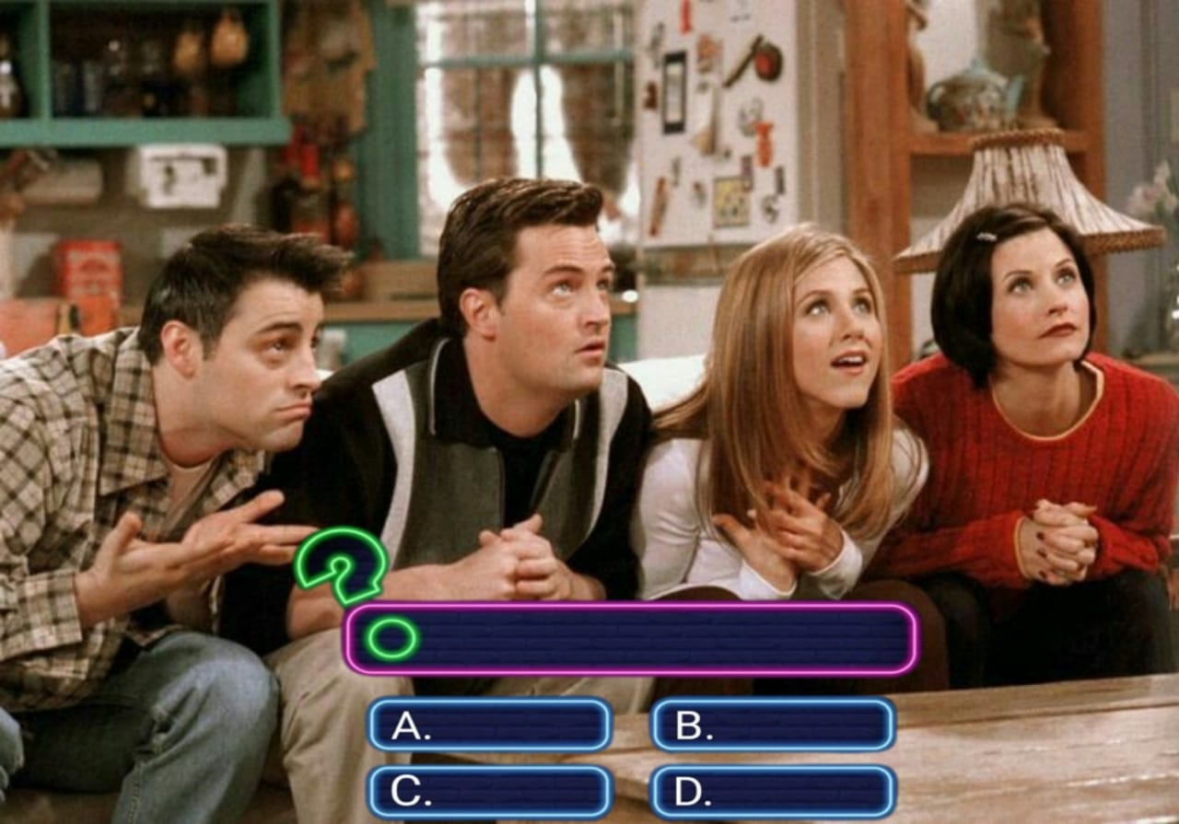
Engaging Quiz Content
To create engaging quiz content, it's important to incorporate multimedia elements such as images, videos, and audio. By using these elements, you can make your quizzes more interactive and visually appealing.
Another way to make your quizzes more engaging is to use interactive elements such as drag-and-drop questions, fill-in-the-blank questions, and matching questions. These types of questions require the user to actively participate in the quiz, making it more enjoyable and memorable.
END OUTCOME :
This Prodathon event taught us teamwork, built everyone's confidence and influenced each other's opinions and most importantly stick to the rules and restrictions and still stay unique from other teams.

